Slide 1
Soumya S Asst Professor Department of History NSS College Pandalam

Slide 2
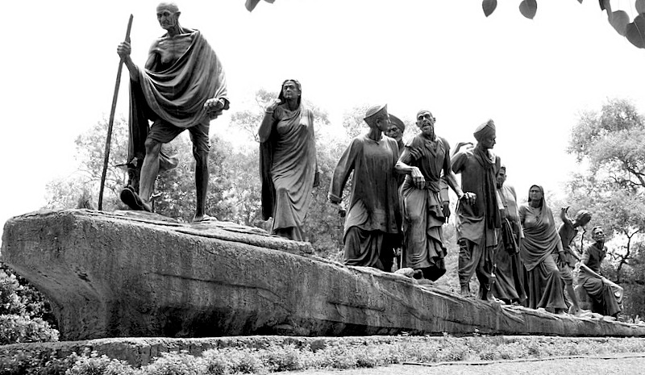
MARCH TO FREEDOM
The great Indian

Slide 3
The early revolts
The revolt of 1857
The Indian rebellion of 1857 was a period of uprising in the northern and central India against East India Company rule,. The conditions of service in the East India Company's army and cantonments increasingly came into conflict with religious beliefs and prejudices of the sepoys. The predominance of members from the upper castes in the army, loss of caste due to overseas travel, and rumors of secret designs of the Government to convert them to Christianity led to deep discontentment among the sepoys The sepoys were also disillusioned by their low salaries and racial discrimination vis-a-vis British officers in matters of promotion and privileges. The indifference of the British towards Indian rulers like the Mughals and ex-Peshwas and the annexation of Oudh were political factors triggering dissent amongst Indians. Dalhousie’s policy of annexation, the doctrine of lapse or escheat, and the projected removal of the descendants of the Great Mughal from their ancestral palace to the Qutb, near Delhi also angered some people.

Slide 4
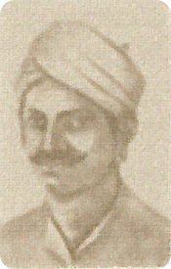
Some leaders of the revolt
Rani Lakshmi Bai
Mangal Panday

Slide 5
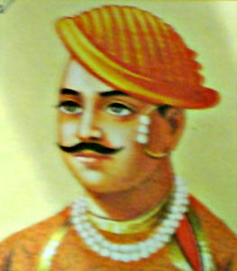
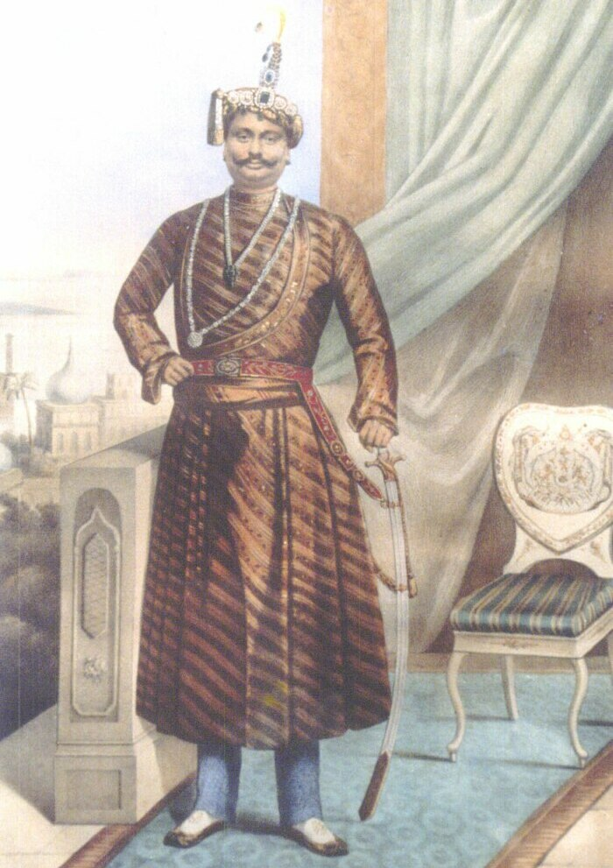
Some leaders of the revolt
Bahadur shah Zafar
Nana Sahib
Tantia Tope

Slide 6
Centers of revolts
Delhi | 1.
Meerut | 2.
Lucknow | 3.
Kanpur | 4.
Jhansi | 5.
Arrah | 6.
Bareily | 7.

Slide 7
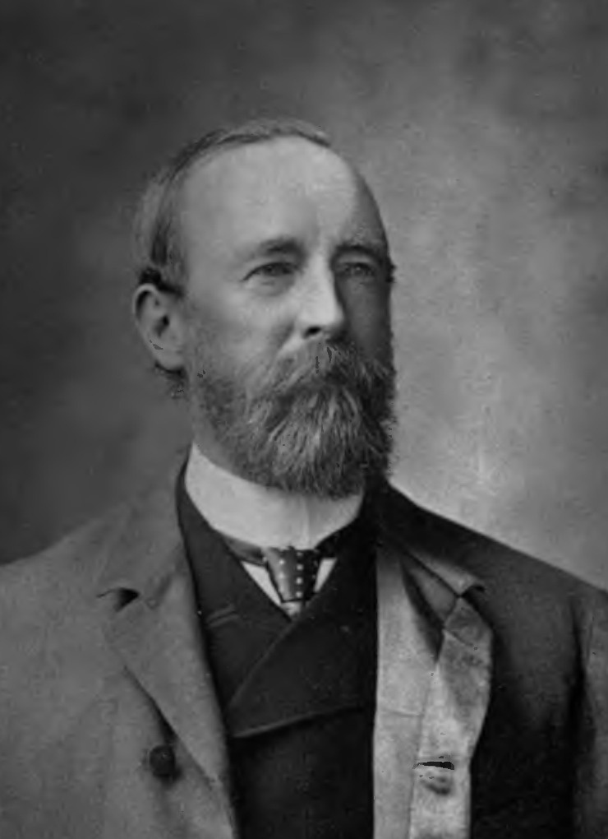
The birth of Indian National Congress
In the later of the 19th Century , many political organization were started in different parts of India. The Indian Association was an organization established in Calcutta in 1876 by Sundernath Banerjea. In 1883, the Indian Association arranged at a national conference in Calcutta. Second national conference was held in 1885 In the same year, A.O. Hume , A retired English Civil Servant Founded the Indian National Congress. The first session was held at Mumbai In December 1885.
A.O. Hume

Slide 9
Rise of organized movements, 1857-1885
The revolt of 1857 was a major turning point in the history of modern India. The British abolished the British East India Company and replaced it with direct rule under the British crown. A Viceroy was appointed to represent the Crown. In proclaiming the new direct-rule policy to "the Princes, Chiefs, and Peoples of India," Queen Victoria promised equal treatment under British law.
The British embarked on a program in India of reform and political restructuring, trying to integrate Indian higher castes and rulers into the government. They stopped land grabs, decreed religious tolerance and admitted Indians into the civil service, albeit mainly as subordinates. They also increased the number of British soldiers in relation to native ones and allowed only British soldiers to handle artillery. Bahadur Shah was exiled to Rangoon, Burma where he died in 1862. In 1877, Queen Victoria took the title of Empress of India.

Slide 10
Partition of Bengal
In 1905, Lord Curzon, the Viceroy and Governor-General (1899–1905), applied the policy of "Divide and Rule" and ordered the partition of the province of Bengal for improvements in administrative efficiency in that huge and populous region, where the Bengali Hindu intelligentsia exerted considerable influence on local and national politics. The partition outraged Bengalis. Not only had the government failed to consult Indian public opinion, but the action appeared to reflect the British resolve to divide and rule. Widespread agitation ensued in the streets and in the press, and the Congress advocated boycotting British products under the banner of swadeshi. People showed unity by tying Rakhi on each other's wrists and observing Arandhan (not cooking any food).
During the partition of Bengal new methods of struggle were adopted. These led to swadeshi and boycott movements. The Congress-led boycott of British goods was so successful that it unleashed anti-British forces to an extent unknown since the Sepoy Rebellion. A cycle of violence and repression ensued in some parts of the country (see Alipore bomb case). The British tried to mitigate the situation by announcing a series of constitutional reforms in 1909 and by appointing a few moderates to the imperial and provincial councils. In what the British saw as an additional goodwill gesture, in 1911 King-Emperor George V visited India for a durbar (a traditional court held for subjects to express fealty to their ruler), during which he announced the reversal of the partition of Bengal and the transfer of the capital from Calcutta to a newly planned city to be built immediately south of Delhi, which later became New Delhi. However, the ceremony of transfer on 23 December 1912 was marked by the attempt to assassinate the then Viceroy, Lord Hardinge, in what came to be known as the Delhi-Lahore conspiracy.

Slide 11
Rise of Indian nationalism
The nationalistic sentiments among Congress members led to the movement to be represented in the bodies of government, to have a say in the lawmaking and administration of India. Congressmen saw themselves as loyalists, but wanted an active role in governing their own country, albeit as part of the Empire. This trend was personified by Dadabhai Naoroji, who went as far as contesting, successfully, an election to the British House of Commons, becoming its first Indian member.
Bal Gangadhar Tilak was the first Indian nationalist to embrace Swaraj as the destiny of the nation. Tilak deeply opposed the British education system that ignored and defamed India's culture, history and values. He resented the denial of freedom of expression for nationalists, and the lack of any voice or role for ordinary Indians in the affairs of their nation. For these reasons, he considered Swaraj as the natural and only solution. His popular sentence "Swaraj is my birthright, and I shall have it" became the source of inspiration for Indians.
In 1907, the Congress was split into two. Tilak advocated what was deemed as extremism. He wanted a direct assault by the people upon the British Raj, and the abandonment of all things British. He was backed by rising public leaders like Bipin Chandra Pal and Lala Lajpat Rai, who held the same point of view. Under them, India's three great states - Maharashtra, Bengal and Punjab shaped the demand of the people and India's nationalism. Gokhale criticized Tilak for encouraging acts of violence and disorder. But the Congress of 1906 did not have public membership, and thus Tilak and his supporters were forced to leave the party.

